Slide 1

A Summary of the Physiology and Evidence-Base for ARDS
“P”s
ARDS
Adam Knox, MD
Karen Halvorson, MD
10/12/2025

Slide 2
Acute Respiratory Distress Syndrome (ARDS)
Diffuse, inflammatory disease
Capillary injury / diffuse alveolar damage
  Multiple cytokines / inflammatory markers implicated
Impaired gas exchange, decreased compliance, R heart strain
THE UNIVERSITY OF ARIZONA
Diamond M, Peniston HL, Sanghavi DK, et al. Acute Respiratory Distress Syndrome. [Updated 2024 Jan 31]. In: StatPearls [Internet]. Treasure Island (FL): StatPearls Publishing; 2025 Jan-. Available from: https://www.ncbi.nlm.nih.gov/books/NBK436002/

Slide 3
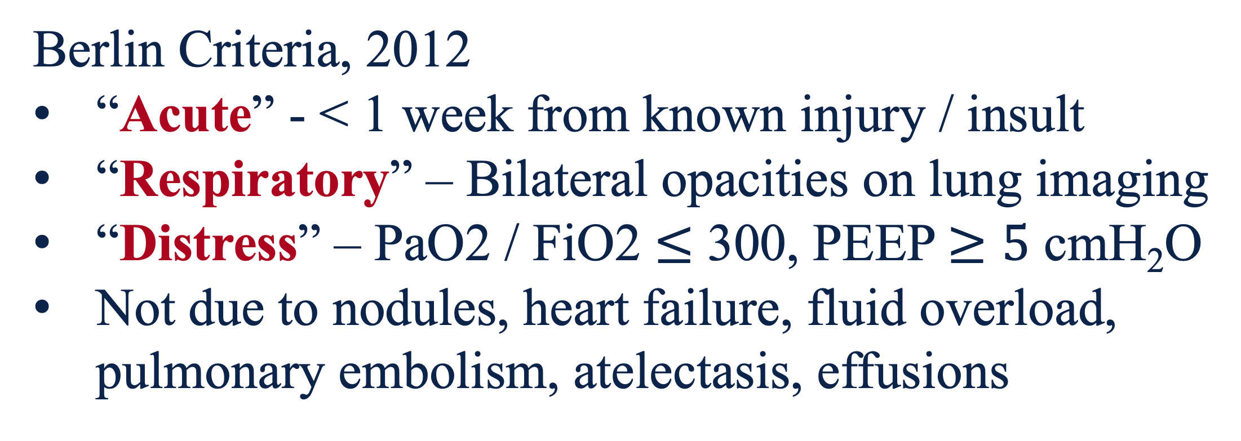
Acute Respiratory Distress Syndrome (ARDS)
Berlin Criteria, 2012
“Acute” - < 1 week from known injury / insult
“Respiratory” – Bilateral opacities on lung imaging
“Distress” – PaO2 / FiO2 $≤$ 300, PEEP $≥5$ cmH₂O
Not due to nodules, heart failure, fluid overload, pulmonary embolism, atelectasis, effusions
THE UNIVERSITY OF ARIZONA
The ARDS Definition Task Force*. Acute Respiratory Distress Syndrome: The Berlin Definition. JAMA. 2012;307(23):2526–2533. doi:10.1001/jama.2012.5669

Slide 4
ARDS Severity, Berlin Criteria
THE UNIVERSITY OF ARIZONA
Severity | PaO₂ / FiO₂
Mild | 300-200
Moderate | 200-100
Severe | <100
Prognosis poor, near 50% mortality rate for severe ARDS
The ARDS Definition Task Force*. Acute Respiratory Distress Syndrome: The Berlin Definition. JAMA. 2012;307(23):2526–2533. doi:10.1001/jama.2012.5669

Slide 5
ARDS – A New Global Definition, 2023
“Acute” - < 1 week from known injury / insult
“Respiratory” – Bilateral opacities on lung imaging
    Includes B lines or consolidations on lung US
“Distress” – PaO2 / FiO2 < 300
    SpO2 / FiO2 criteria to decrease arterial punctures
    Includes HFNC >30 L/min without PEEP req.
    New criteria for intubated / nonintubated ARDS
THE UNIVERSITY OF ARIZONA
Matthay, Michael A., et al. “A New Global Definition of Acute Respiratory Distress Syndrome.” American Journal of Respiratory and Critical Care Medicine, vol. 209, no. 1, 24 July 2023, pubmed.ncbi.nlm.nih.gov/37487152/, https://doi.org/10.1164/rccm.202303-0558WS.

Slide 6
ARDS – A New Global Definition, 2023
Non-intubated ARDS
PaO2:FiO2 ⩽ 300 mm Hg or
SpO2:FiO2 ⩽ 315 (if SpO2 ⩽ 97%) on HFNO with flow of ⩾30 L/min or
NIV/CPAP with at least 5 cm H2O end-expiratory pressure
Intubated ARDS
THE UNIVERSITY OF ARIZONA
Severity | PaO₂ / FiO₂ | SpO₂ / FiO₂
Mild | 300-200 | 315-235
Moderate | 200-100 | 235-148
Severe | <100 | <148
Matthay, Michael A., et al. “A New Global Definition of Acute Respiratory Distress Syndrome.” American Journal of Respiratory and Critical Care Medicine, vol. 209, no. 1, 24 July 2023, pubmed.ncbi.nlm.nih.gov/37487152/, https://doi.org/10.1164/rccm.202303-0558WS.

Slide 7
Common ARDS Causes
Pneumonia
Non-pulmonary sepsis
Pancreatitis
Aspiration
Trauma
Inhalation
Transfusion
THE UNIVERSITY OF ARIZONA
Acute respiratory distress syndrome: causes, pathophysiology, and phenotypes. Bos, Lieuwe D J et al.
The Lancet, Volume 400, Issue 10358, 1145 - 1156

Slide 8
The P’s of ARDS
ByPass (ECMO)
Pulm Vasodilators
THE UNIVERSITY OF ARIZONA
Pee
Paralytics
Prednisone (Dexamethasone)
Proning
Lung Protective Ventilation

Slide 9
THE UNIVERSITY OF ARIZONA
Lung Protective Ventilation

Slide 10
Lung Protective Ventilation – ARMA / ARDSNET
P – Adults meeting criteria for ARDS
I – 6 cc/kg IBW, pplat < 30 cmH2O
C – 12 cc/kg IBW, pplat <50 cmH2O
O - Improved 6-month mortality
Significance: Lower ventilatory volumes and pressures became standard of care, NNT 6
THE UNIVERSITY OF ARIZONA
Amato MBP, Meade MO, Slutsky AS, et al. Driving pressure and survival in the acute respiratory distress syndrome. N Engl J Med. 2015;372(8):747-755
The Acute Respiratory Distress Syndrome Network. (2000). Ventilation with lower tidal volumes as compared with traditional tidal volumes for acute lung injury and the acute respiratory distress syndrome. New England Journal of Medicine, 342(18), 1301–1308. DOI: [10.1056/NEJM200004273421801]

Slide 11
Lung Protective Ventilation – Driving Pressure
P – 3562 patients
Methods – Multilevel mediation analysis of driving pressure in ARDS
O - Driving pressure bests stratifies risk, decreasing driving pressure on ventilator associated with improved mortality
Driving pressure = Pplat (inspiratory hold) – Peep, goal < 15 cmH2O
THE UNIVERSITY OF ARIZONA
Amato MBP, Meade MO, Slutsky AS, et al. Driving pressure and survival in the acute respiratory distress syndrome. N Engl J Med. 2015;372(8):747-755

Slide 12
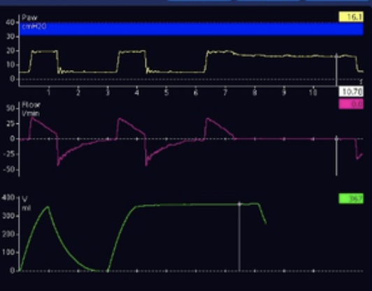
Lung Protective Ventilation – Driving Pressure
Inspiratory hold maneuver
Plateau pressure
THE UNIVERSITY OF ARIZONA
PEEP
Driving Pressure = Pplat - PEEP

Slide 13








Decreased functional lung space in ARDS
Systemic inflammation damages lung capillary membrane, leads to capillary leak / alveolar damage
THE UNIVERSITY OF ARIZONA
0
0
¼ V
¾ V
V

Slide 14
Lung Protective Ventilation Prevents
1) Volutrauma
3) Atelectotrauma
2) Barotrauma
THE UNIVERSITY OF ARIZONA

Slide 15
THE UNIVERSITY OF ARIZONA
Proning
Lung Protective Ventilation

Slide 16
Proning – ProSeva Trial
P – Intubated patients w/ severe ARDS, P:F<150, FiO2 >60%, PEEP 5
I – Prone positioning x 16 hours, supination x 4, repeated if still severe
C - Regular, supine positioning
O – Significantly decreased 28 and 90 day mortality, NNT 10
THE UNIVERSITY OF ARIZONA
Guerin, R., et al. (2013). Prone positioning in severe acute respiratory distress syndrome. New England Journal of Medicine, 368(23), 2159–2168.

Slide 17
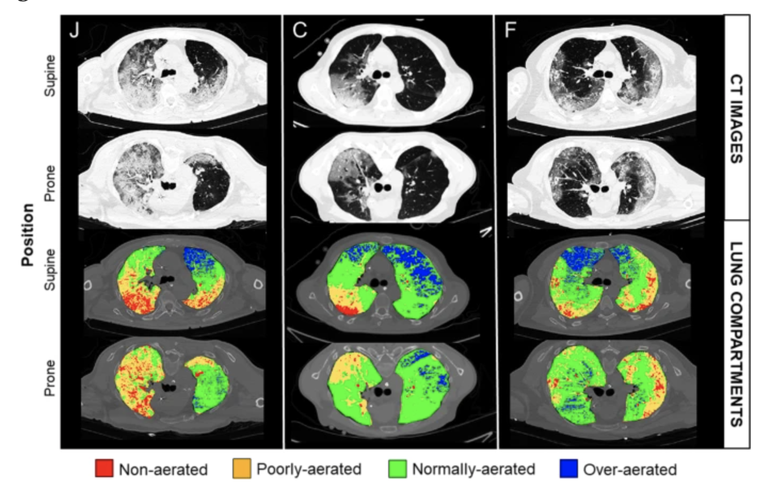
Proning
Improves V/Q mismatch
Offloads R heart
Improves mortality
THE UNIVERSITY OF ARIZONA
Protti, A., Santini, A., Pennati, F. et al. Lung response to prone positioning in mechanically-ventilated patients with COVID-19. Crit Care 26, 127 (2022). https://doi.org/10.1186/s13054-022-03996-0

Slide 18
THE UNIVERSITY OF ARIZONA
Prednisone (Dexamethasone)
Proning
Lung Protective Ventilation

Slide 19
“Prednisone” aka Dex – DEXA-ARDS Trial
P – 277 patients with ARDS, P:F < 200, PEEP >10, FiO2 >50%
I – Dexamethasone 20 mg daily x 5 days, then 10 mg daily x 5 days
C – No steroid therapy
O – More ventilator-free days, improved 60 day mortality
Significance – Consider steroid-responsive conditions, including severe PNA (CAPE COD trial)
THE UNIVERSITY OF ARIZONA
Villar J, Ferrando, et al;. Dexamethasone treatment for the acute respiratory distress syndrome: a multicentre, randomised controlled trial. Lancet Respir Med. 2020 Mar;8(3):267-276. doi: 10.1016/S2213-2600(19)30417-5. Epub 2020 Feb 7. PMID: 32043986.

Slide 20
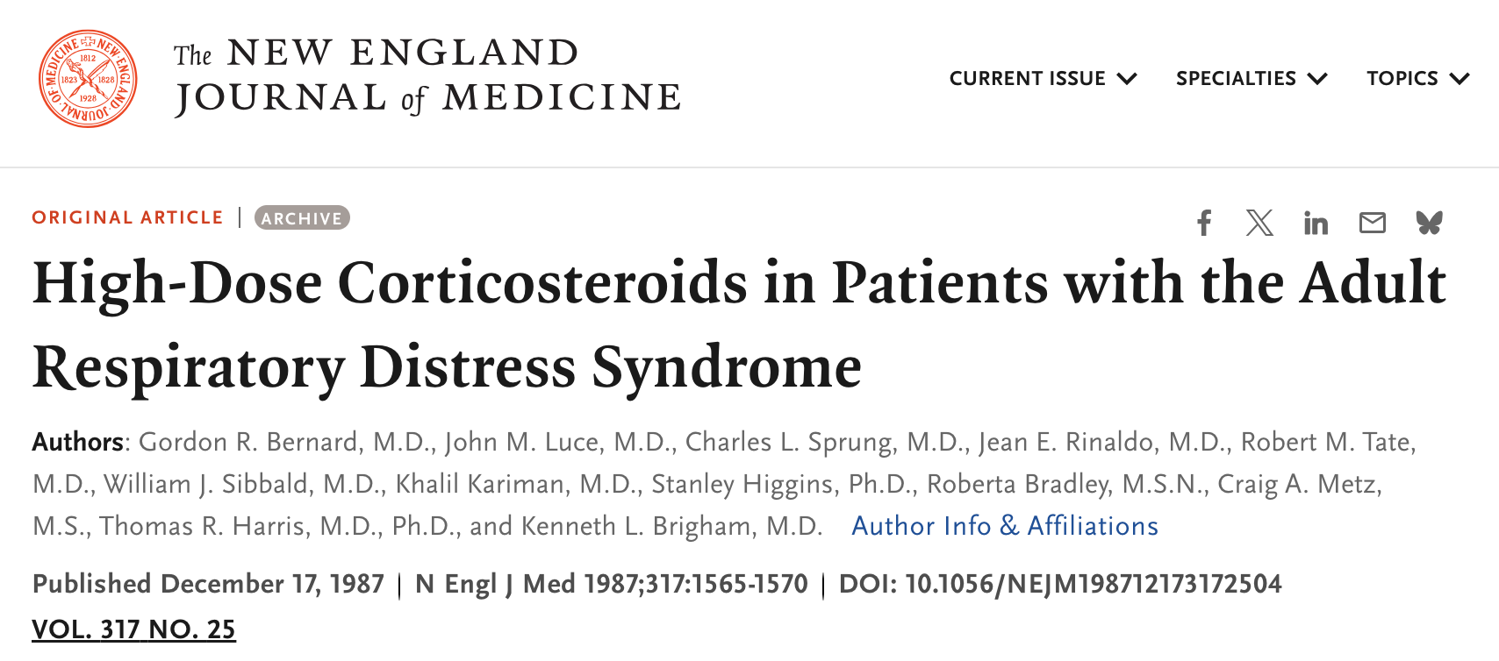
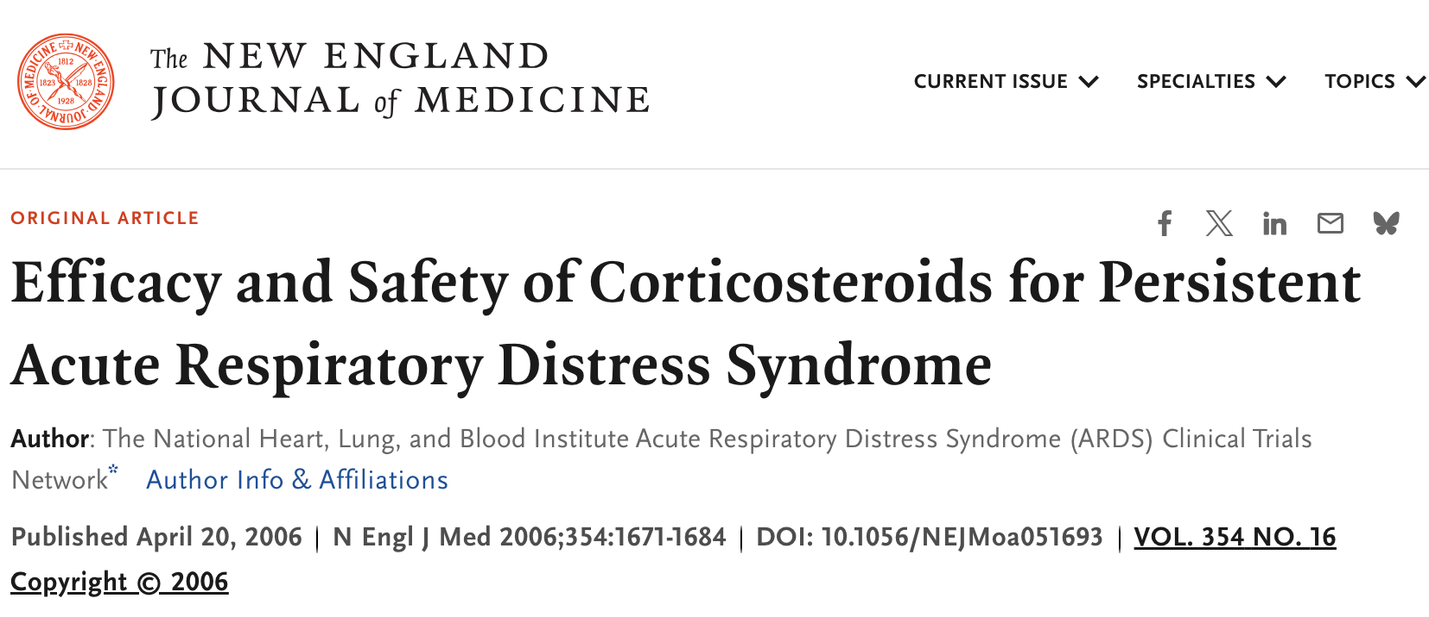
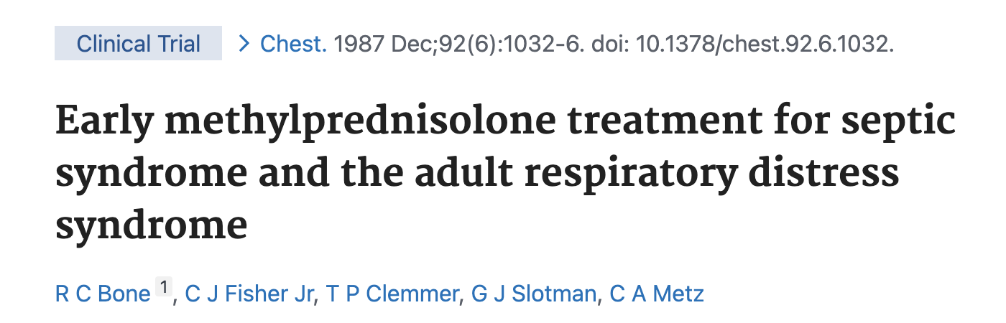
Caveat – Prior studies suggested against steroids
THE UNIVERSITY OF ARIZONA
If steroids given, earlier is better than later!

Slide 21
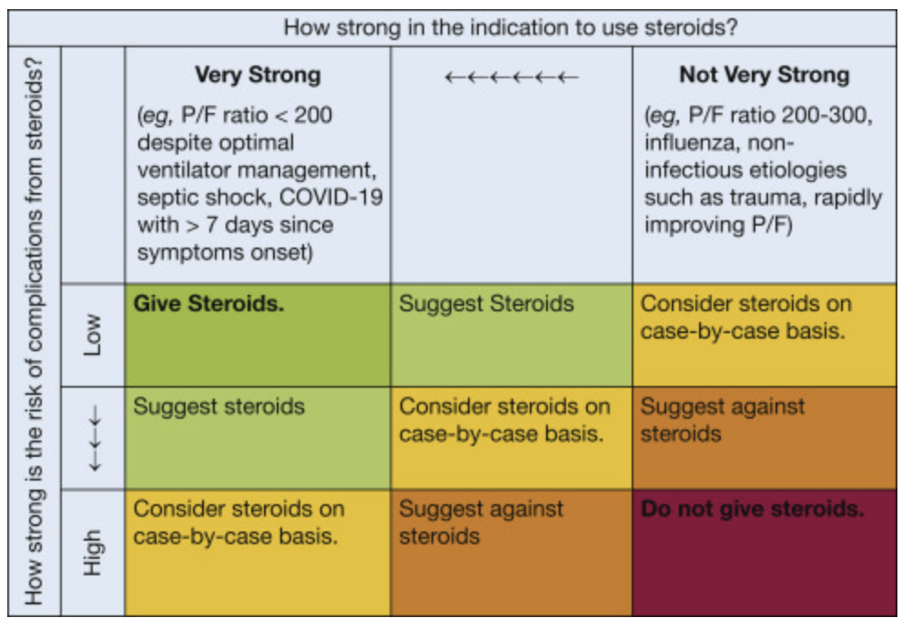
A reasonable framework for steroids in ARDS
THE UNIVERSITY OF ARIZONA
COUNTERPOINT: Should Corticosteroids Be Routine Treatment in Early ARDS? No. Hensley, Matthew K. et al. CHEST, Volume 159, Issue 1, 29 - 33

Slide 22
THE UNIVERSITY OF ARIZONA
Paralytics
Prednisone (Dexamethasone)
Proning
Lung Protective Ventilation

Slide 23
Paralytics – Improve compliance, use if needed
ROSE (2019)
ACURASYS (2020)
P – 1006 ARDS patients, P:F < 150, PEEP >8
I – Continuous cisatracurium x 48h w/ deep sedation
C – Usual care
O – Stopped early for futility, no mortality difference, increased cardiovascular events (4 vs 14, P=0.02) and worse mobility with paralytic
P – 340 ARDS patients, P:F < 150, PEEP >5
I – Continuous cisatracurium x 48h w/ deep sedation
C – Usual care
O – Improved adjusted 90-day mortality with paralytic therapy
THE UNIVERSITY OF ARIZONA
National Heart, Lung, and Blood Institute PETAL Clinical Trials Network. Early neuromuscular blockade in the acute respiratory distress syndrome. N Engl J Med. 2019;380(21):1997-2008
Papazian L, Forel JM, Gacouin A, et al; ACURASYS Study Investigators. Neuromuscular blockers in early acute respiratory distress syndrome. N Engl J Med. 2010;363(12):1107-1116

Slide 24
THE UNIVERSITY OF ARIZONA
Pee
Paralytics
Prednisone (Dexamethasone)
Proning
Lung Protective Ventilation

Slide 25
“Pee” / Conservative Fluid Strategy – FACTT Trial (2006)
P – 1,000 patients with ALI (P:F <300, bilateral infiltrates, no elevated LA pressure)
I - Liberal fluid strategy (CVP 10-14), targeted with fluids / lasix
C – Conservative fluid strategy (CVP <4)
O – No mortality difference, improved ventilator-free days with conservative strategy
THE UNIVERSITY OF ARIZONA
Wiedemann HP, et al. Comparison of two fluid-management strategies in acute lung injury. N Engl J Med. 2006

Slide 26
Dry Lungs are Happy Lungs!
Not every patient has CVC or reliable CVP readings
Common practice: Use Lasix to at least keep patient net even
Prioritize hemodynamics
THE UNIVERSITY OF ARIZONA

Slide 27
Pulm Vasodilators
THE UNIVERSITY OF ARIZONA
Pee
Paralytics
Prednisone (Dexamethasone)
Proning
Lung Protective Ventilation

Slide 28
Pulm Vasodilators – CHEST Guidelines
Inhaled prostacyclins improve oxygenation and mPAP, very low quality evidence
Improved V/Q mismatch
Improved RV hemodynamics
Subtypes may benefit more than others
No mortality benefit
THE UNIVERSITY OF ARIZONA

Slide 29
ByPass (ECMO)
Pulm Vasodilators
THE UNIVERSITY OF ARIZONA
Pee
Paralytics
Prednisone (Dexamethasone)
Proning
Lung Protective Ventilation

Slide 30
ByPass - ECMO Candidacy for ARDS
EOLIA Trial / Criteria for ECMO
  P:F <50 x 3h
  P:F <80 x 6h
  pH <7.25, CO2 >60 x 6h
11% absolute mortality difference favoring ECMO for above indications, P=0.09
High crossover rate skews results
THE UNIVERSITY OF ARIZONA
Combes, A. et al. Extracorporeal membrane oxygenation for severe acute respiratory distress syndrome. New England Journal of Medicine, 378(21), 1965-1975. doi.org

Slide 31
Summary
Diagnosis primarily made with P:F ratio, chest radiograph, clinical course
Definitive mortality-improving measures for ARDS include:
  Lung protective ventilation (TV 6-8 cc/kg, Plat<30, DP < 15)
  Proning
  Possibly steroids
Many other adjunctive therapies available
THE UNIVERSITY OF ARIZONA
Combes, A. et al. Extracorporeal membrane oxygenation for severe acute respiratory distress syndrome. New England Journal of Medicine, 378(21), 1965-1975. doi.org

Slide 32


Thank you
PRESENTATION TITLE | THE UNIVERSITY OF ARIZONA

